Slide 1
Affordable, simple ACA Compliance for small businesses

Slide 2
What on Earth is a 1095-C?
The 1095-C is a new IRS form that is required to be filed annually by all employers with more than 50 full-time/full-time equivalent employees
The Affordable Care Act (ACA) has an “employer mandate” that most employers must offer insurance; the 1095-C is the enforcement mechanism so the IRS knows who to fine for non-compliance
The first forms are due 1/31/2016, for the year 2015

Slide 3
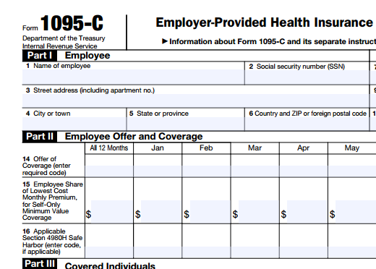
What is to be reported?
Each 1095-C will contain (per employee):
Demographic information
What coverage (if any) was offered
The cost of such coverage
What “Safe Harbors” can apply to avoid an IRS Penalty
Also, a single 1094-C cover sheet will summarize information for the employer.

Slide 4
How will employers prepare them?
Using data from payroll software, HR packages, employee databases, and insurance bills, forms can be prepared by:
Payroll vendors (ADP, Paychex, etc.)
HR management vendors (TRAX, etc.)
CPA/bookkeeping firms
Internal staff
…but at what cost?

Slide 5
The Problem…
Payroll vendors are quoting $10,000+ to many small businesses, plus ongoing monthly fees and extensive software implementations
HR management vendors are almost as expensive, but complex and invasive
CPA/bookkeeping firms don’t
want to touch this
Internal staff would struggle to
self-prepare

Slide 6
Why 1095 EZ Online?
Software agnostic: it doesn’t matter what payroll/HR/management software is currently used
Non-invasive: doesn’t “integrate” with any system
Easy-to-use: the user experience is a familiar, simple Excel data template
Turn-key: no extensive training necessary, and instead can get started on day one
Affordable: pay one-time annually for form preparation at a fraction of competitors’ cost

Slide 7
Limitations
As the low-cost, no-frills option, we are not designed to handle certain employer setups (such as self-insured plans, unstable/seasonal workforce, complex insurance offerings). A pre-agreement questionnaire is used to determine if we can accept a client.
Due to recently published IRS e-File instructions, we as a small consulting company do not have the programming horsepower to implement the IRS electronic security measures and IRS file mapping. We are therefore capped at a 250 paper return limit.

Slide 8
What employers should use 1095 EZ Online?
Employers with fewer than 250 true full-time employees (regardless of number of FTEs)
Employers that are very cost-sensitive
Employers that do not want to implement and manage new software
Employers that do in-house payroll and do not want to bring in a payroll vendor
Employers that receive all bookkeeping from a third-party firm that has not addressed ACA Compliance

Slide 9
To learn more…
Visit www.1095EZ.com:
View the EDUCATION tab for much more information about the forms, regulations, and IRS guidelines
Learn ABOUT US and OUR SERVICES to see how we can solve this new requirement
Get to know our insurance broker PARTNERS
CONTACT us for a quote or to sign-up!

